Slide 1

Supermarket Sales Analysis

Slide 2
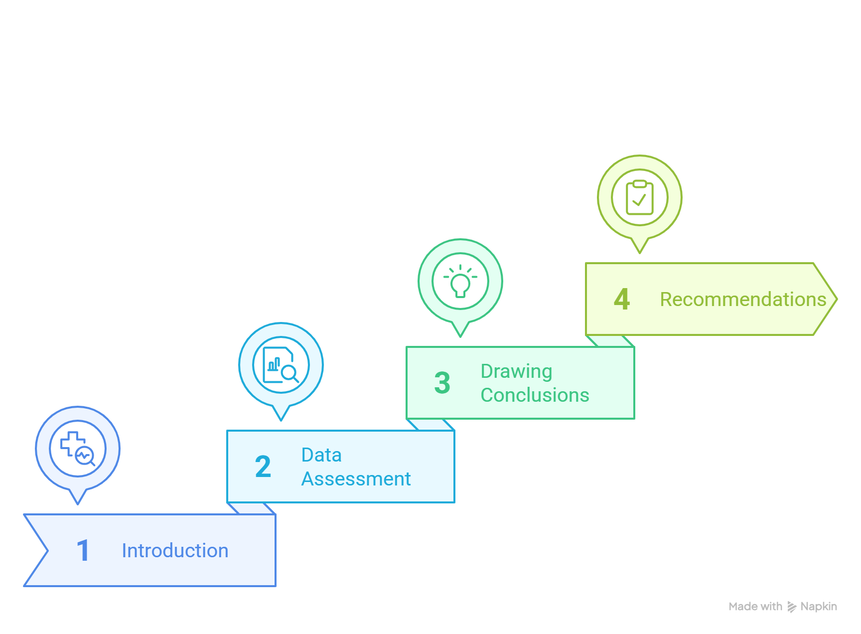
Analysis Outline

Slide 3
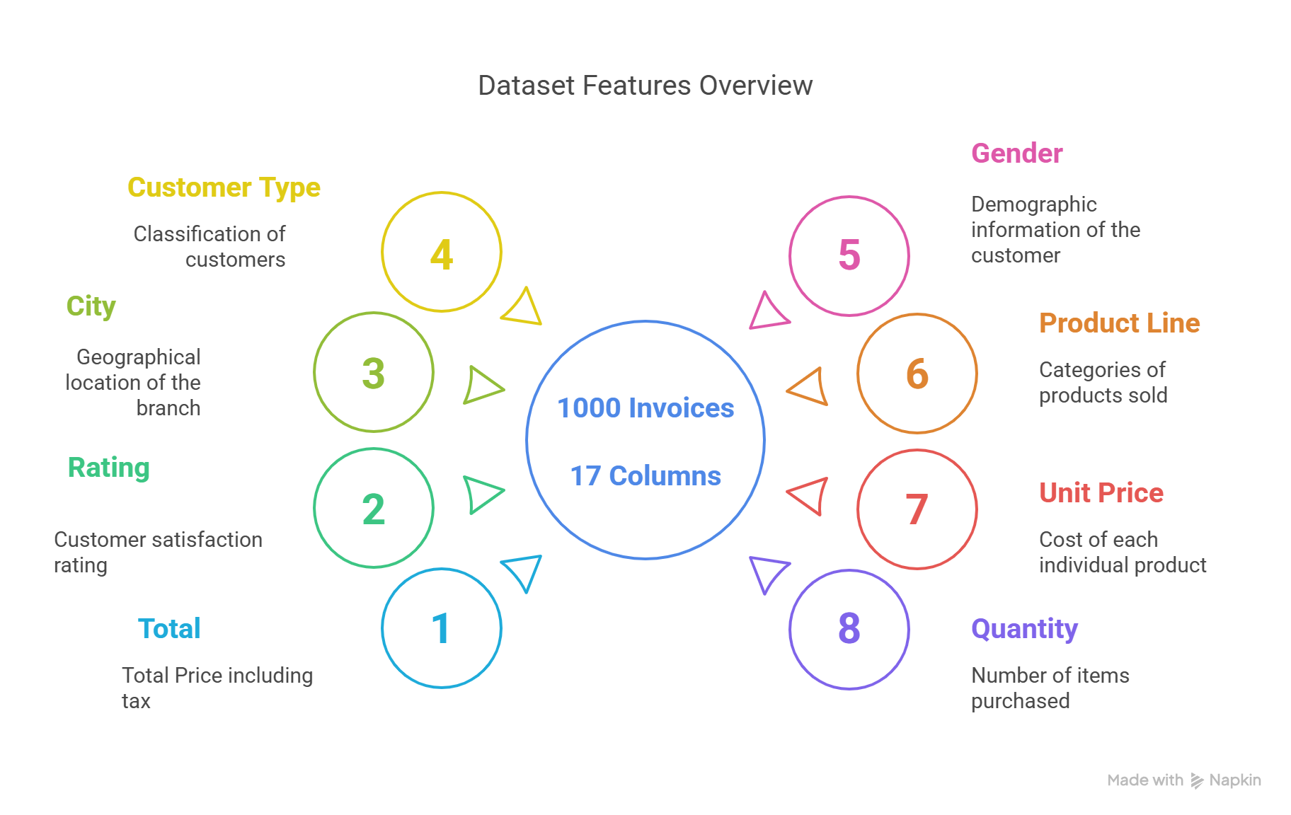
Introduction

Slide 4
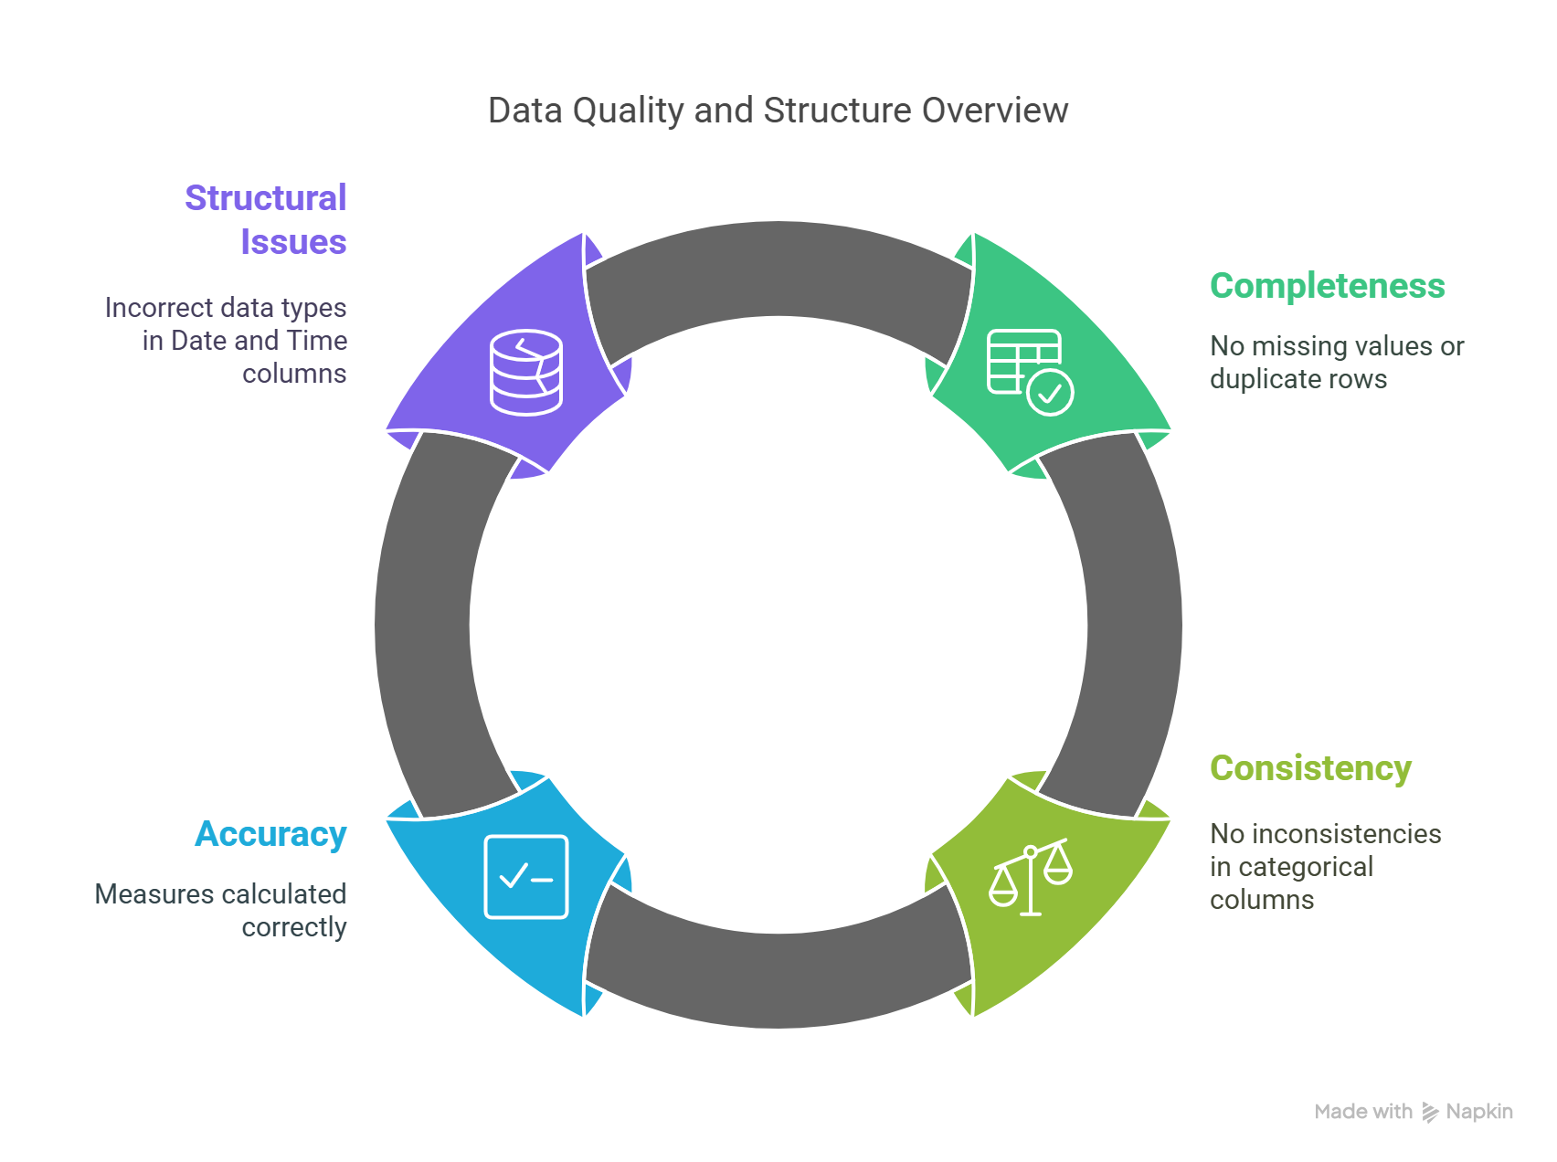

Data Assessment

Slide 5
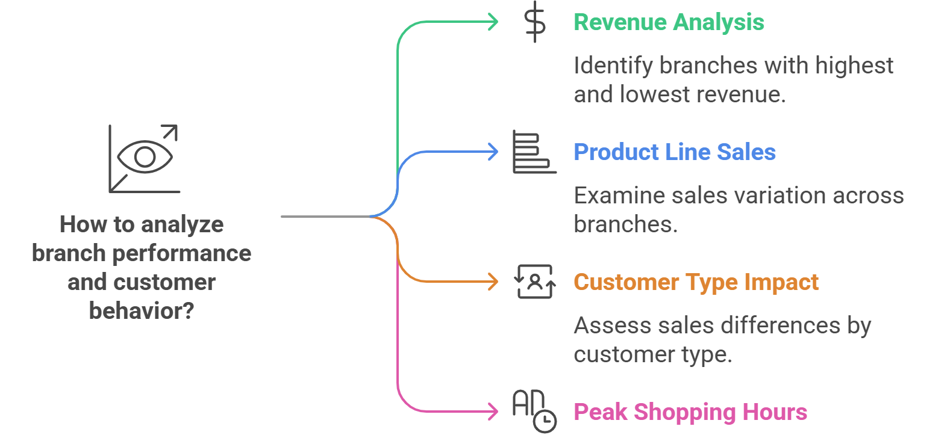
Drawing Conclusions

Slide 6
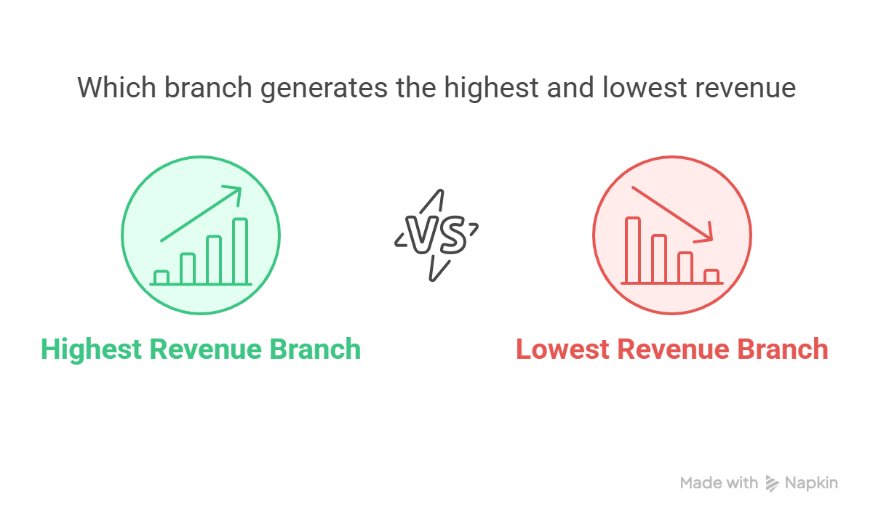

Slide 7
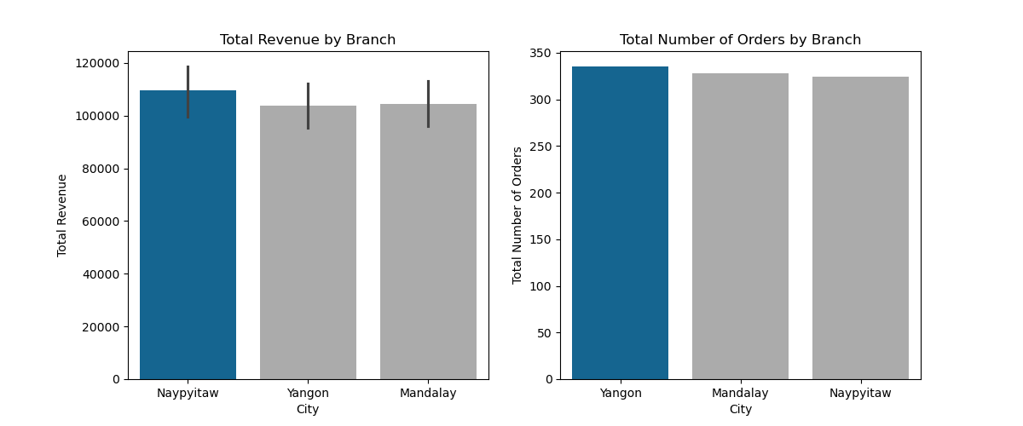
Which branch generates the highest and lowest revenue?
The Naypyitaw branch shows slightly higher revenue than the other branches.
Although the Yangon and Mandalay branches sold slightly more orders than the Naypyitaw branch, Naypyitaw has higher revenue, indicating that the Naypyitaw branch may have sold more high-value orders or orders that have larger order size.

Slide 8


Slide 9
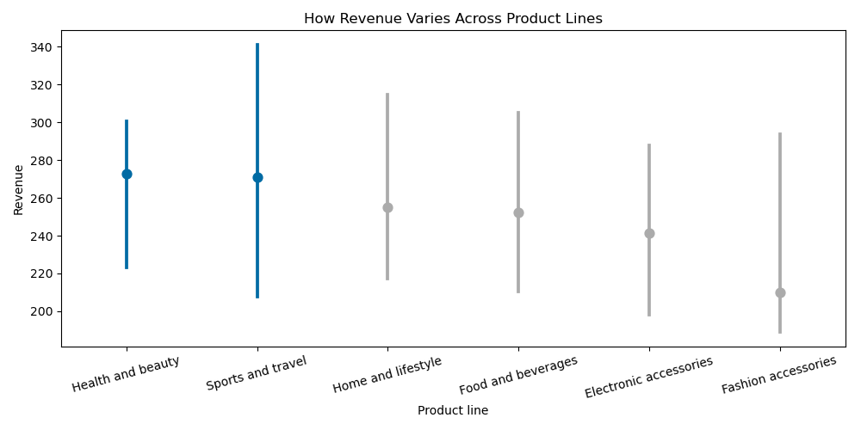
How do product line sales vary across branches?
Fashion accessories has the lowest revenue while Health and beauty and Sports and travel achieve the highest.

Slide 10
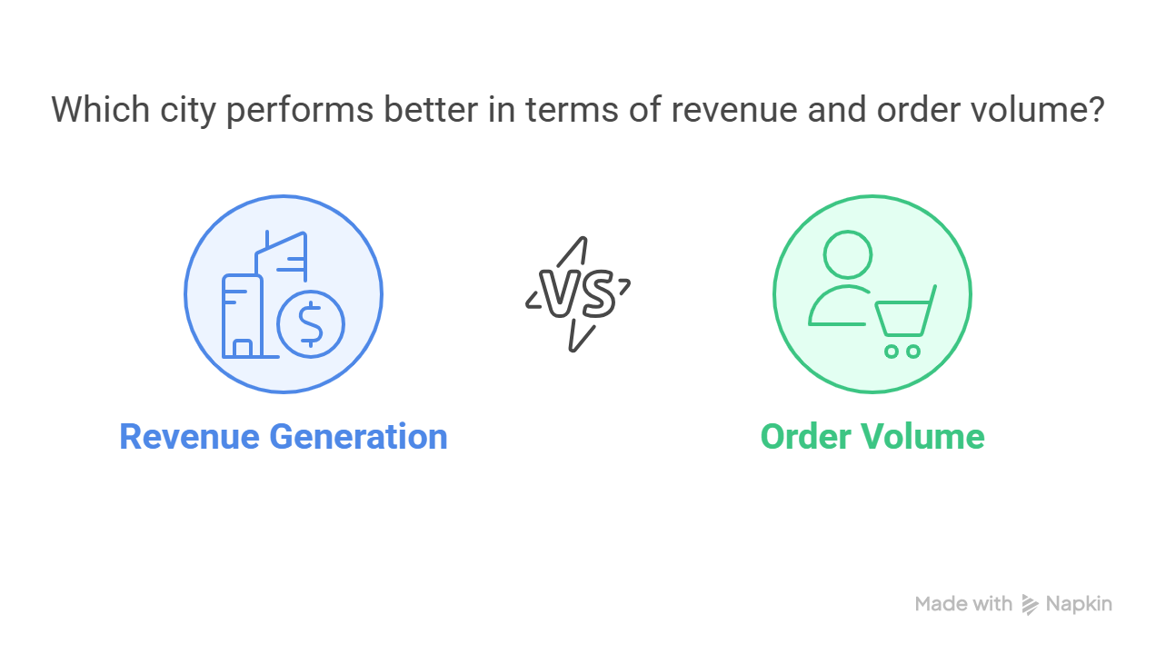


Slide 11
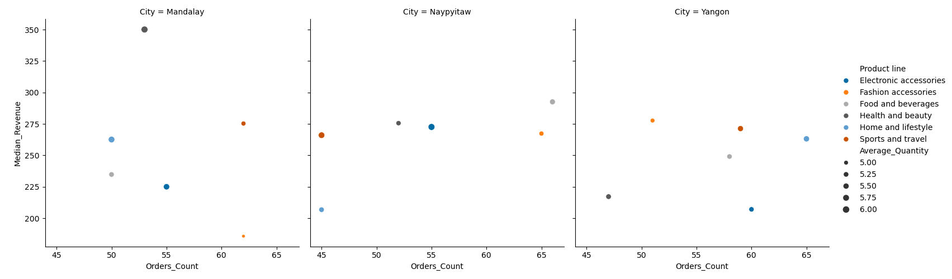
How do product line sales vary across branches?
In Mandalay, despite Health and Beauty not having the highest number of orders, it achieves the highest revenue among all categories in all cities. Additionally, the Sports and Travel category has higher revenue than Fashion Accessories despite having the same number of orders.

Slide 12
How do product line sales vary across branches?
In Naypyitaw, all categories are performing well compared to other categories in other cities, except for the Home and Lifestyle category, which has low revenue and a low number of orders.

Slide 13
How do product line sales vary across branches?
In Yangon, the Electronic Accessories category has a high number of orders but low revenue. Also, the Health and Lifestyle category has both low revenue and a low number of orders.

Slide 14



Slide 15
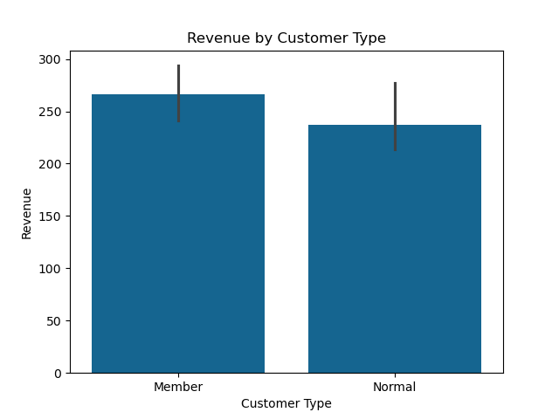
Does customer type (Members vs. Normal) affect sales differently at each branch?
We can see that customers who are members achieve slightly higher revenue than those who are not.

Slide 16
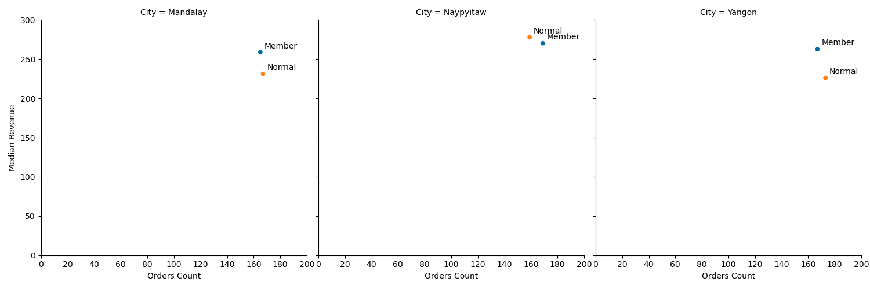
Does customer type (Members vs. Normal) affect sales differently at each branch?
In Mandalay and Yangon, members generate slightly higher revenue than normal customers, but normal customers place more orders.

Slide 17
Does customer type (Members vs. Normal) affect sales differently at each branch?
In Naypyitaw, revenue is very close between both groups, but member customers have more orders than normal customers.

Slide 18
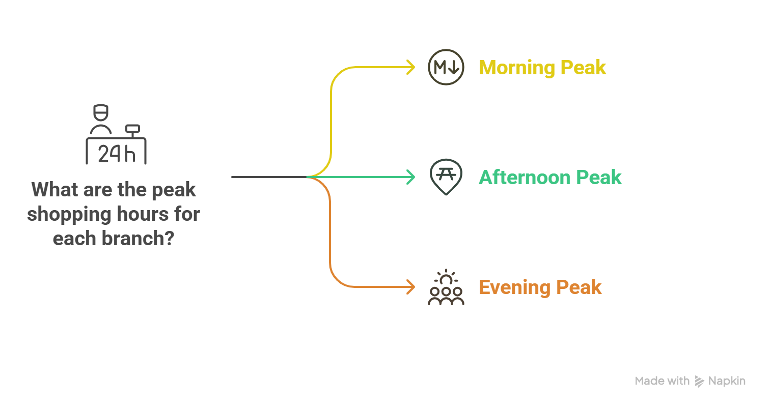


Slide 19
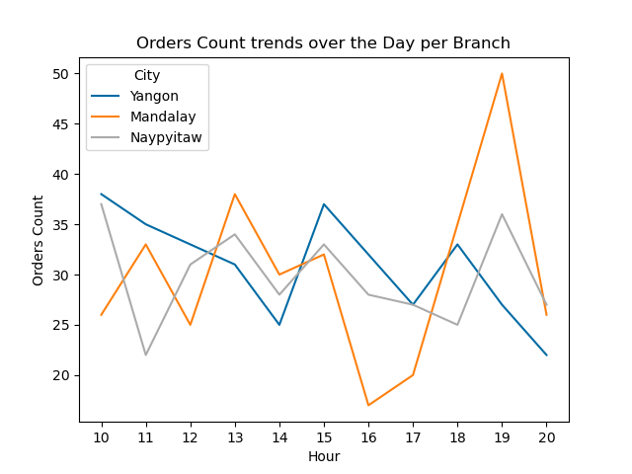
What are the peak shopping hours for each branch?
The order count in the Mandalay branch significantly dropped at 16:00 and 17:00 before rising again, reaching its peak at 19:00.
In Naypyitaw and Yangon, order counts fluctuate normally throughout the day and never drop below 20 or exceed 40 in any given hour.

Slide 20


Slide 21
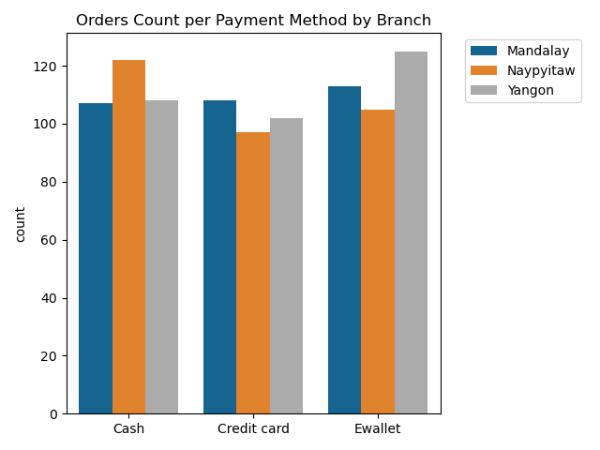
Are certain payment methods more popular at specific branches?
E-wallets are used more in the Yangon branch, while cash is used more in the Naypyitaw branch, and credit cards are used more in the Mandalay branch.

Slide 22
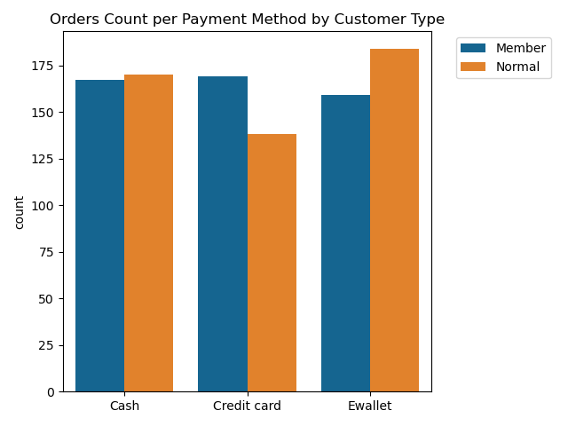
Orders Count per Payment Method by Customer Type
Members use credit cards more than normal customers. On the other hand, normal customers use e-wallets and cash more than member customers.

Slide 23
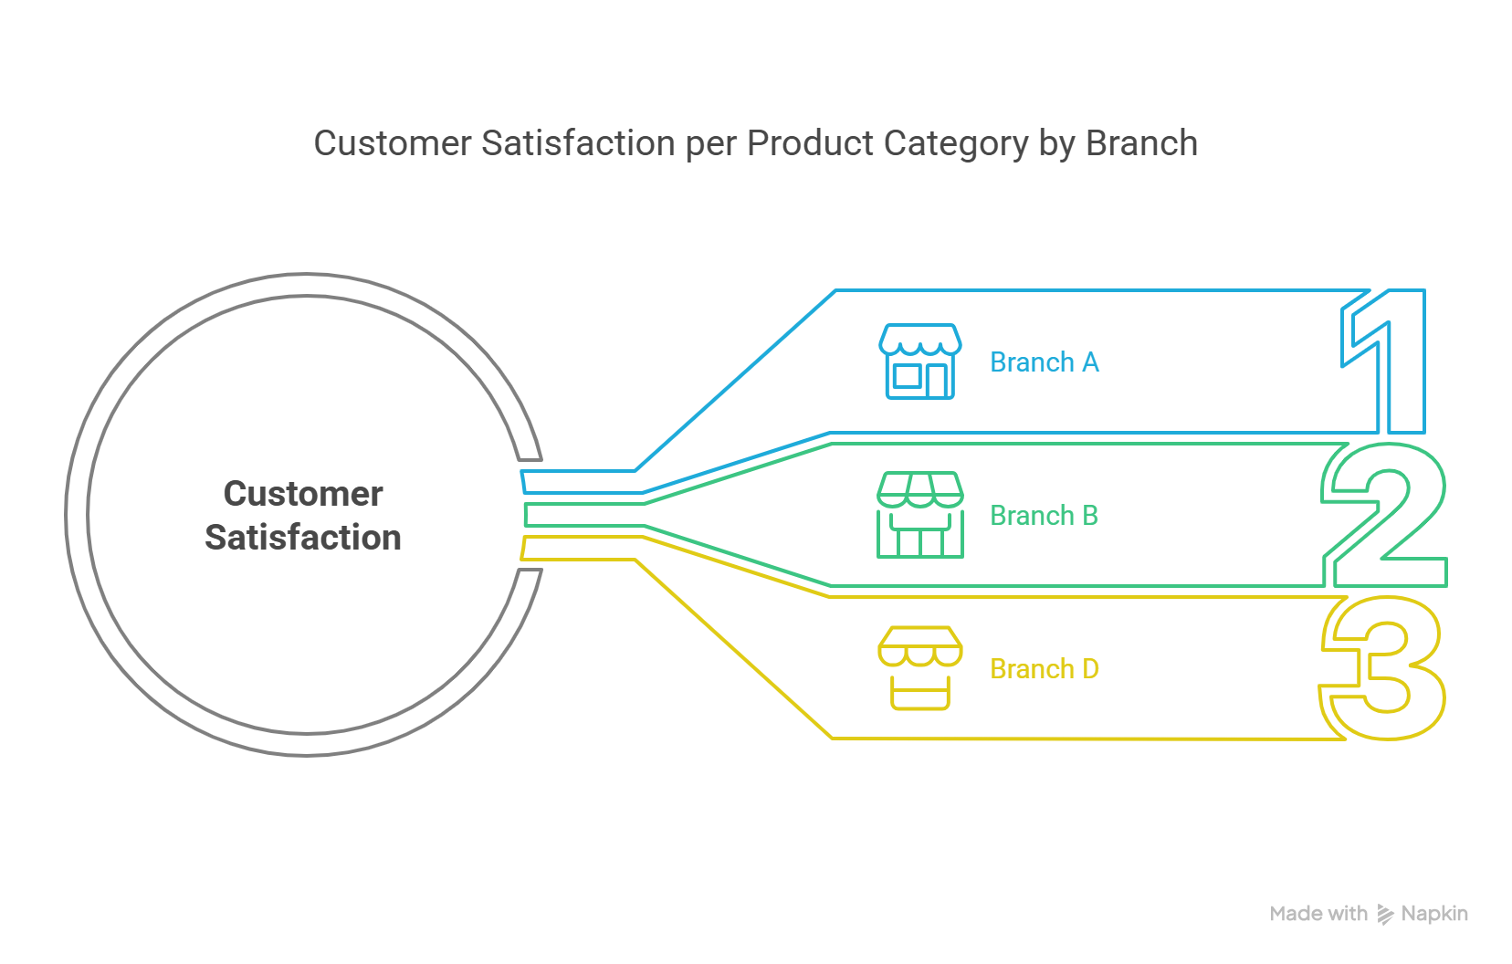

Slide 24
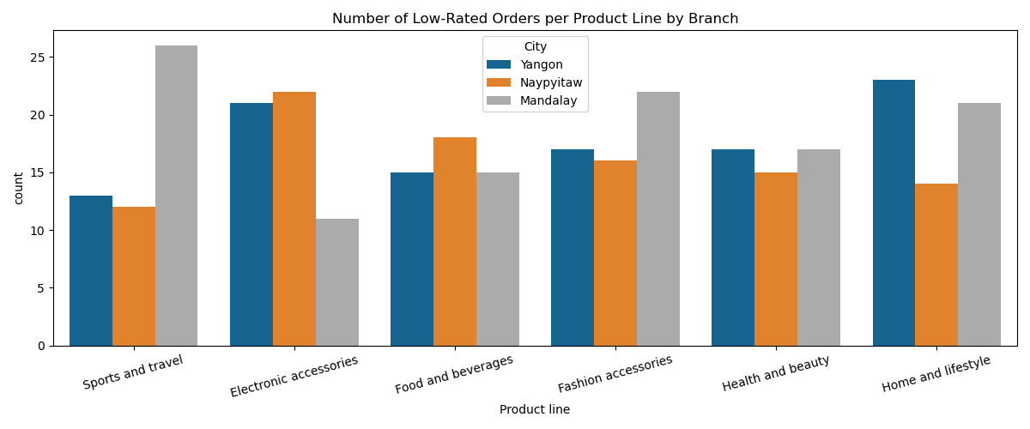
Orders Count per Payment Method by Customer Type
Most of the low-rated orders in the Sports and travel and Fashion accessories categories are in the Mandalay branch.

Slide 25
Orders Count per Payment Method by Customer Type
Most of the low-rated orders in Electronic accessories are in the Yangon and Naypyitaw branches.

Slide 26
Orders Count per Payment Method by Customer Type
Most of the low-rated orders in Food and beverages are in the Naypyitaw branch.

Slide 27
Orders Count per Payment Method by Customer Type
Most of the low-rated orders in Home and Style are in the Yangon and Mandalay branches.

Slide 28
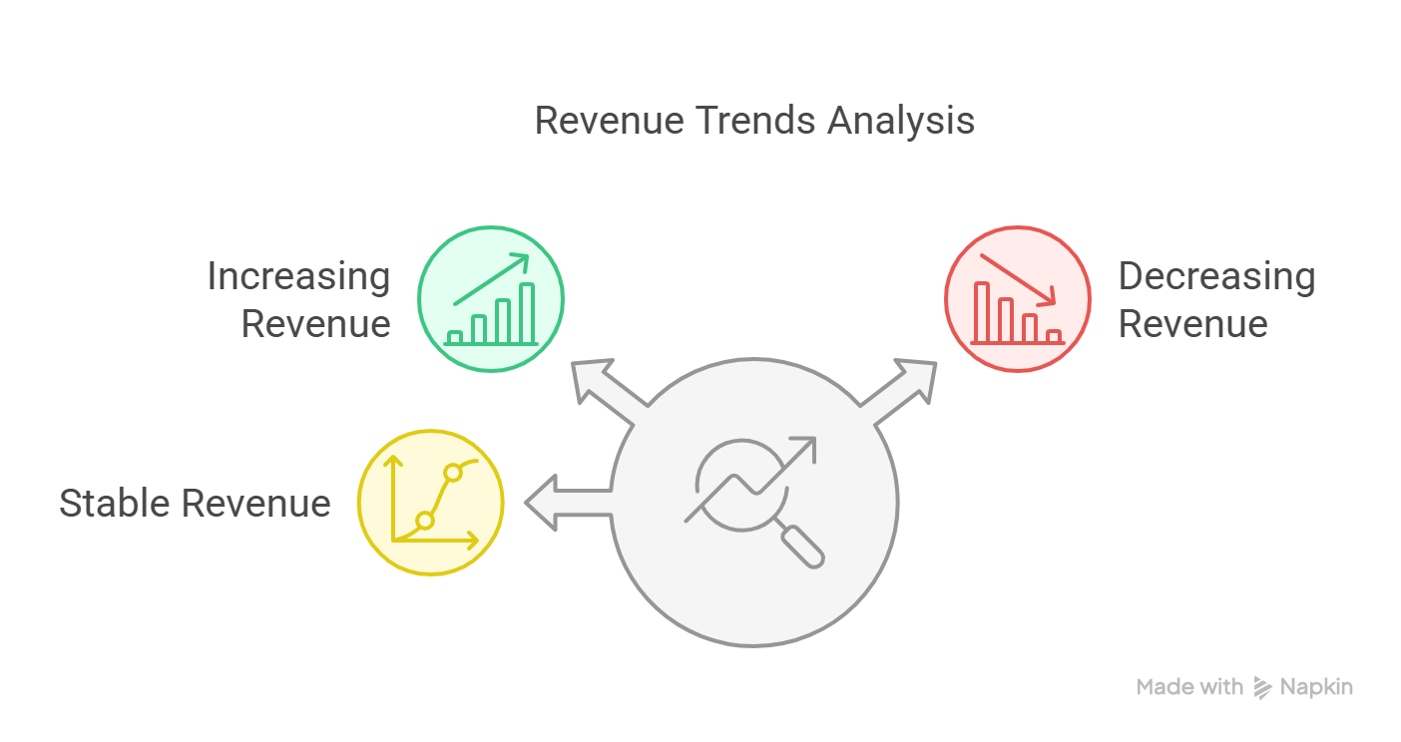


Slide 29
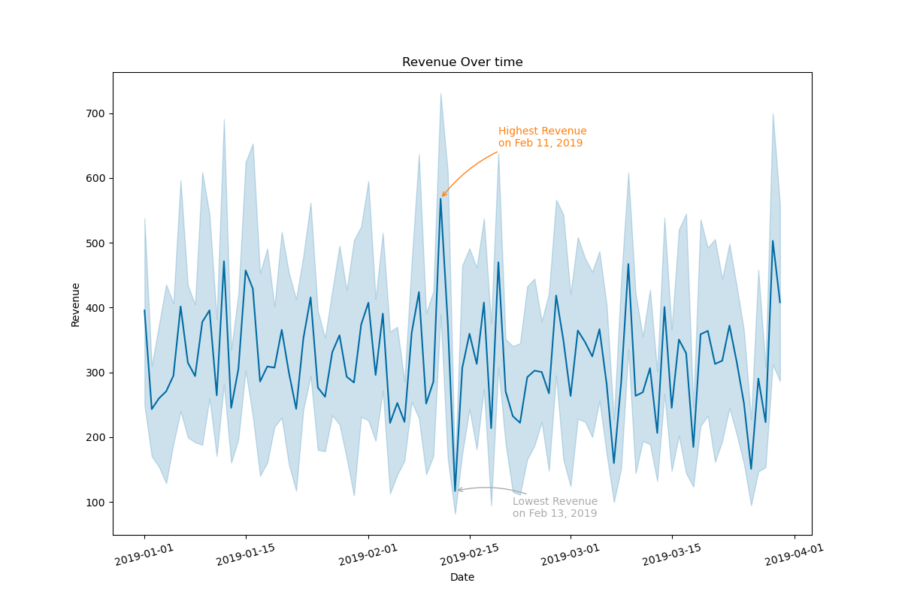
What are the trends in revenue over the past three months?
There are significant fluctuations in revenue, and interestingly, we achieved both the highest and lowest revenue in February.

Slide 30
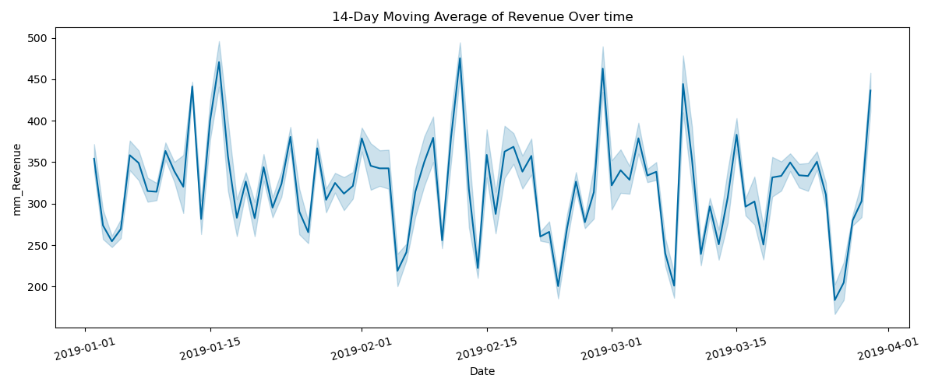
What are the trends in revenue over the past three months?
In general, We can say that there is a sudden increase in revenue at the start or the middle of each month.

Slide 31


Slide 32
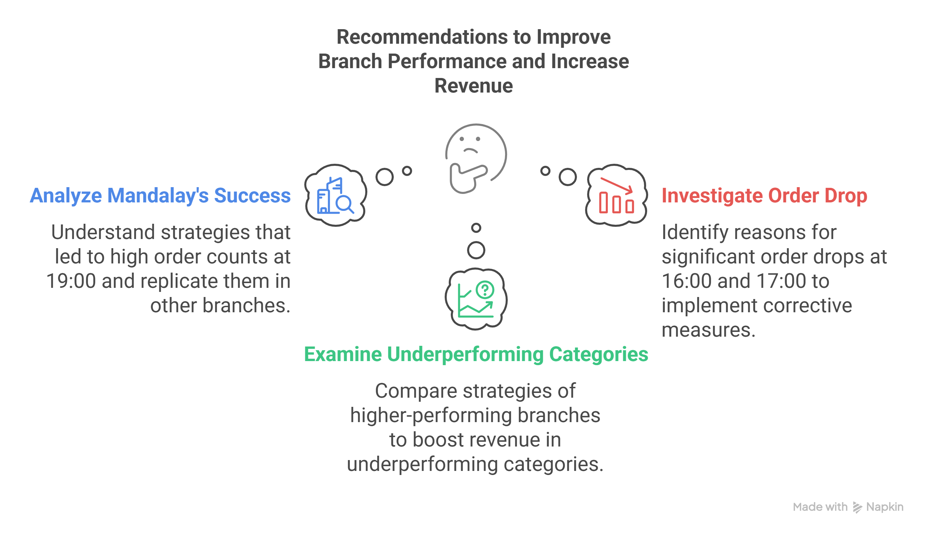


Slide 33
